Slide 1
CSE 317: (Un)Informed Search
Dr. Mohammed Eunus Ali
Professor
Department of Computer Science and Engineering
Bangladesh University of Engineering and Technology (BUET)
Dhaka-1000, Bangladesh
Email: eunus@cse.buet.ac.bd

Slide 2
Uninformed Search Methods
Depth-First Search
Breadth-First Search
Uniform-Cost Search
Informed Search Methods
Heuristics
Greedy Search
A* Search

Slide 3
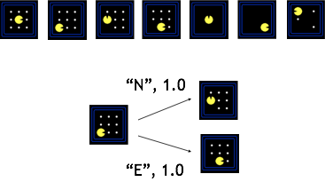
Search Problems
A search problem consists of:
A state space
A successor function
(with actions, costs)
A start state and a goal test
A solution is a sequence of actions (a plan) which transforms the start state to a goal state

Slide 4
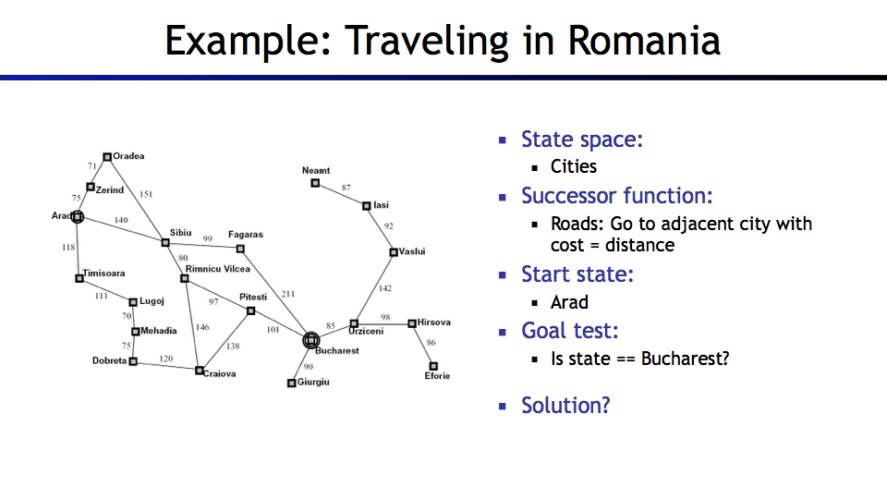
An Example

Slide 5
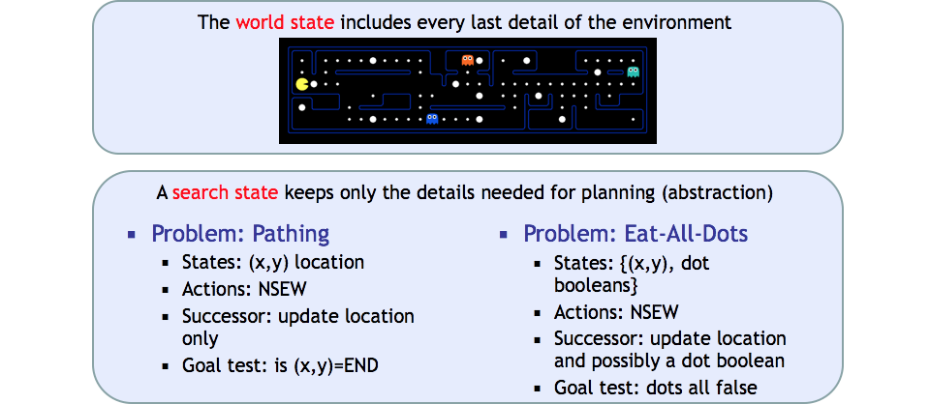
What is in State Space

Slide 6
State Space Graph
State space graph: A mathematical representation of a search problem
Nodes are (abstracted) world configurations
Arcs represent successors (action results)
The goal test is a set of goal nodes (maybe only one)
In a state space graph, each state occurs only once!
We can rarely build this full graph in memory (it’s too big), but it’s a useful idea

Slide 7
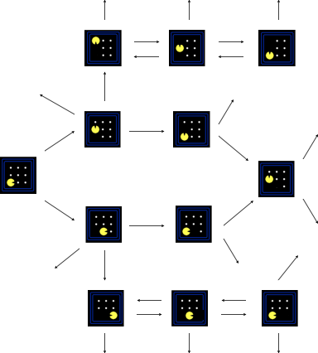
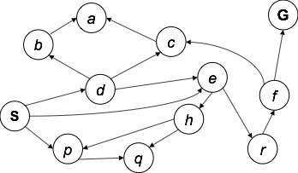
Examples

Slide 8
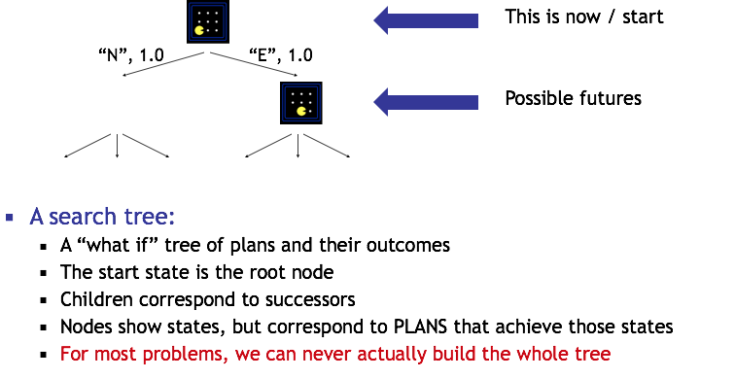
Search Tree

Slide 9
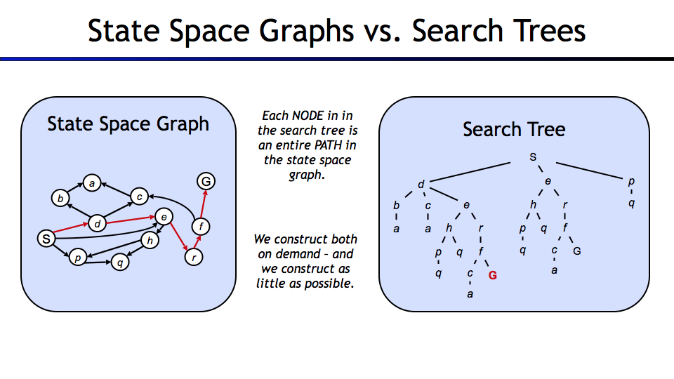

Slide 10
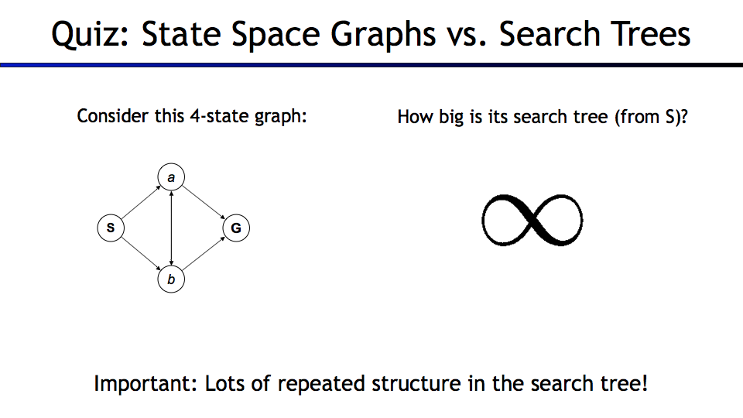

Quiz!!!
What is the name of Google AI system that beats the world champion of the incredibly complex Chinese board game GO.
Answer: AlphaGO
10

Slide 11
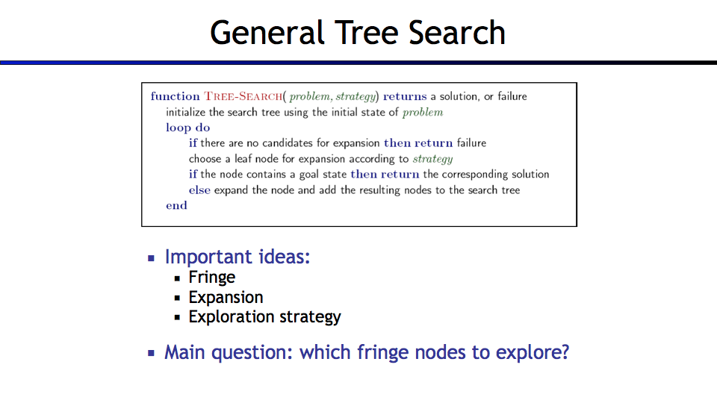
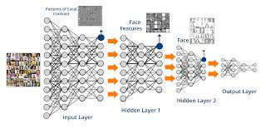
Quiz!!!
An area of AI has recently become popular that imitates the workings of human brain in processing data and making decisions…
Answer: Deep Learning
11

Slide 12
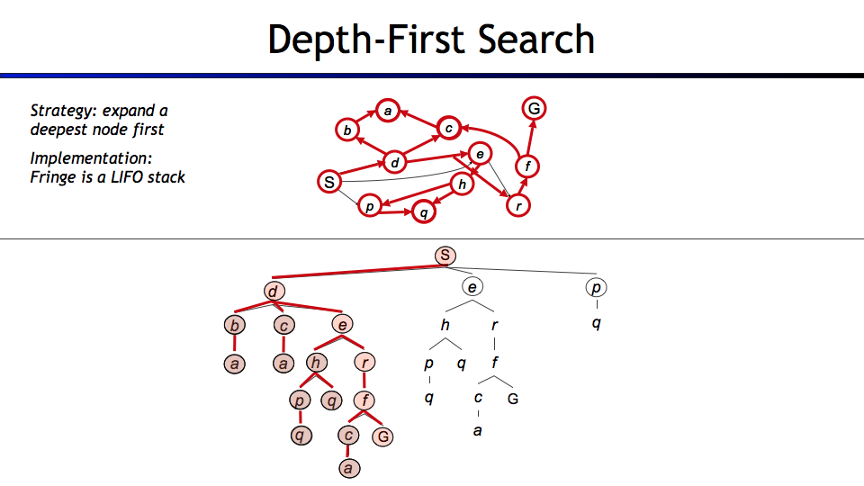
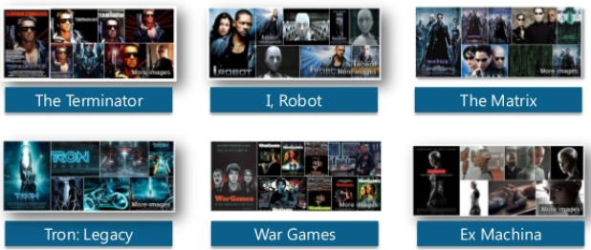
Sci-fi Movies and Artificial Intelligence!
12

Slide 13
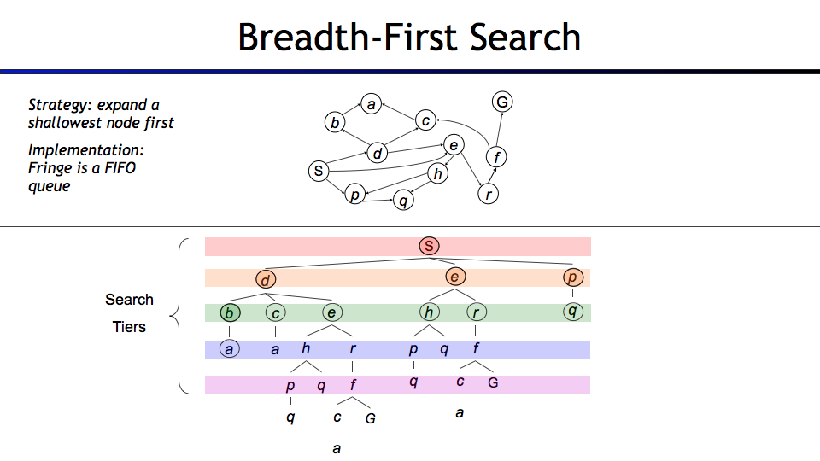

What is Artificial Intelligence?
Artificial intelligence is the intelligence exhibits by machines rather than humans or other animals
AI research is
the study of intelligent agents, where any device can perceive its environment and take actions that maximize its chance of success at some goal
13

Slide 14
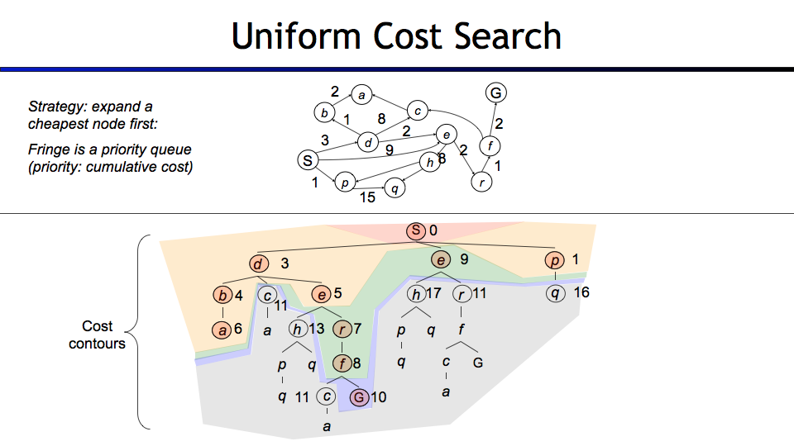
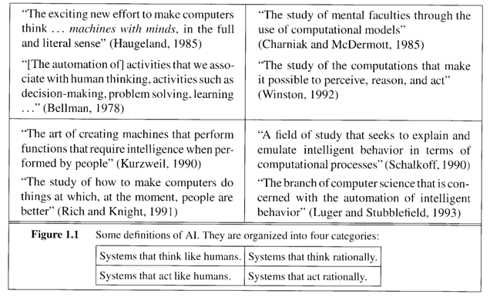
Uniform Cost Search

Slide 15
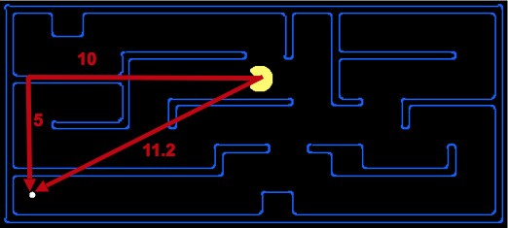
A heuristic is:
A function that estimates how close a state is to a goal
Designed for a particular search problem
Examples: Manhattan distance, Euclidean distance for pathing

Slide 16
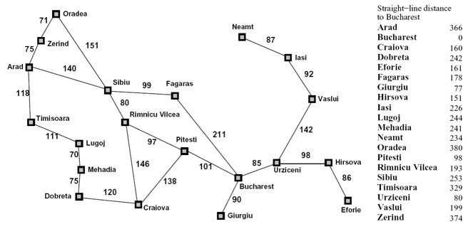

Slide 17
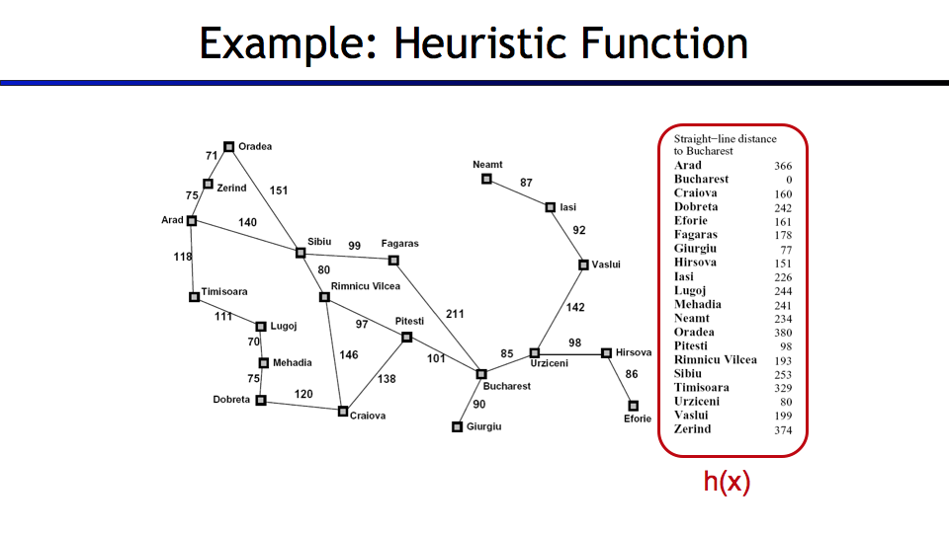

Slide 18
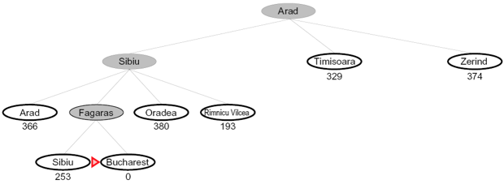
Greedy Search
Strategy: expand a node that you think is closest to a goal state
Heuristic: estimate of distance to nearest goal for each state

Slide 19
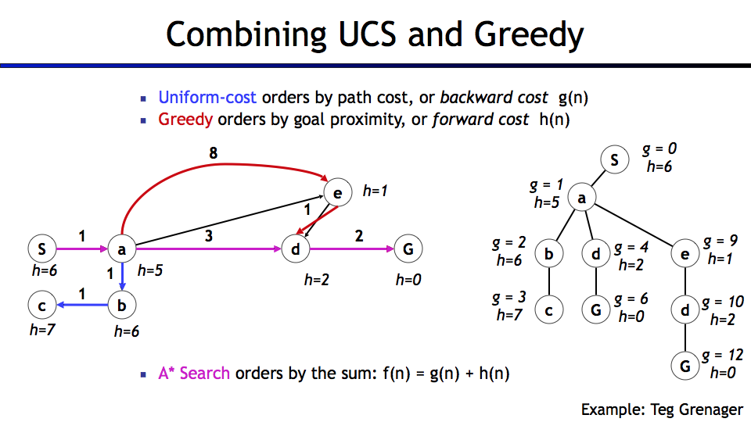
A*-Search

Slide 20
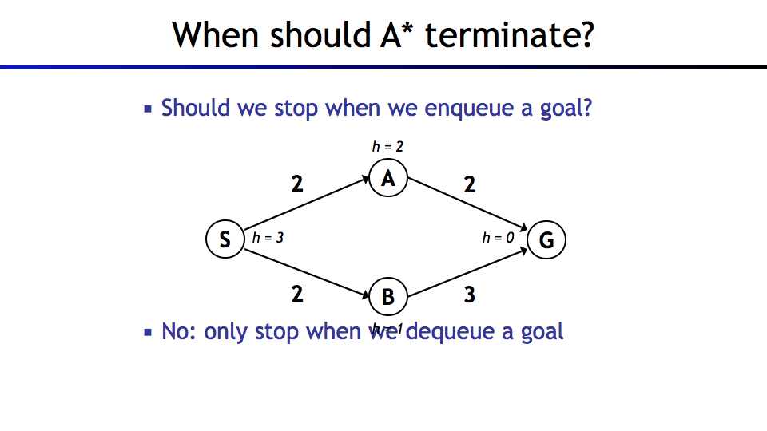

Slide 21
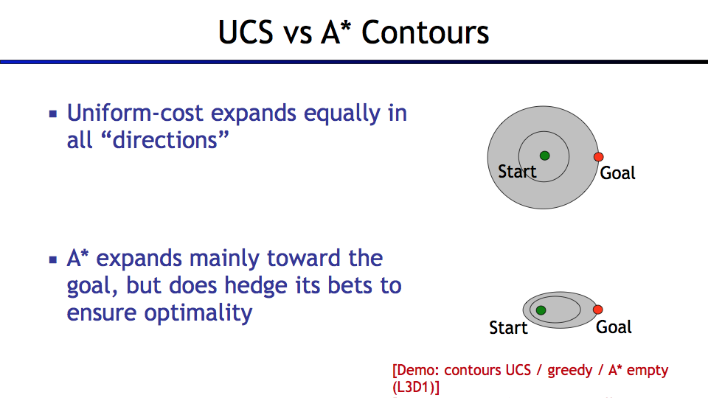

Slide 22
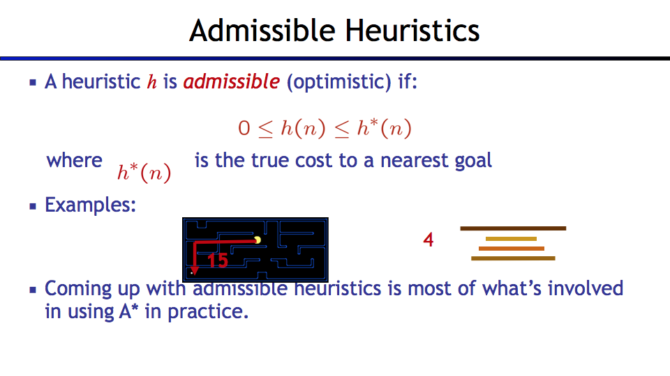
Admissible

Slide 23
